Slide 1
Shell Bootcamp 2024 3 Reflections for Week #4
Khushi Garg
Date : -19-sept-2024

Slide 2

About Me
Stay vigilant, trust but verify, and protect what matters.

Slide 3

My learnings from this week!

Slide 4
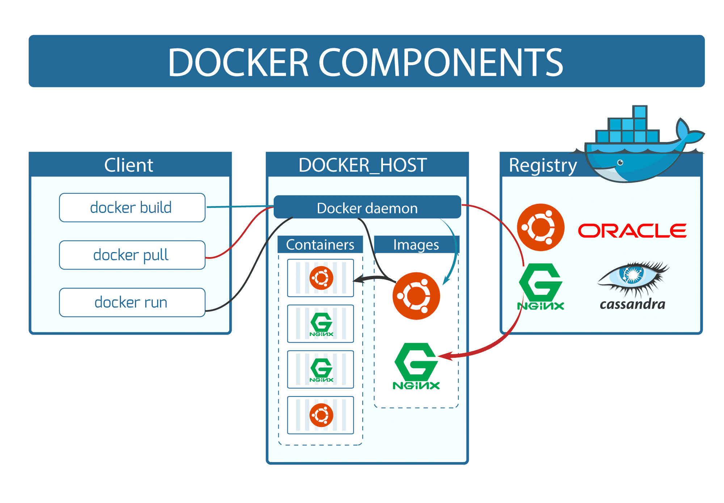
Learning 1 | My takeaways
Key learning
Docker is a platform that allows developers to automate the deployment of applications inside lightweight, portable containers. These containers include everything needed to run the application, ensuring consistency across different environments.
Docker Compose is a tool for defining and running multi-container Docker applications, using a YAML file to configure services.

Slide 5
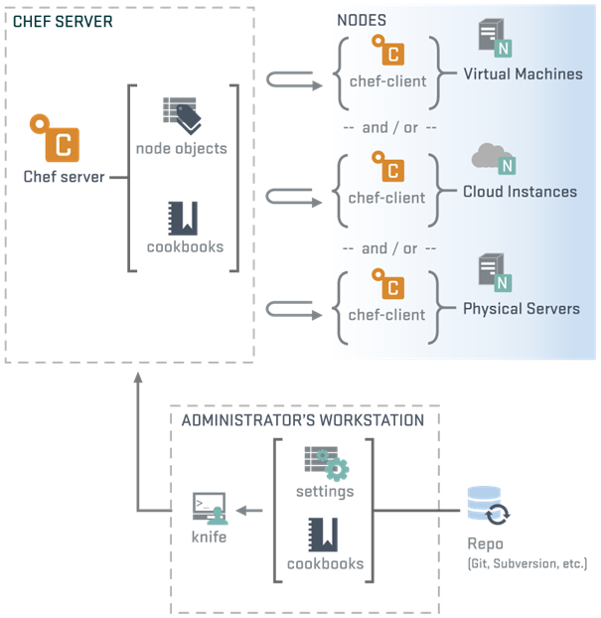
Learning 2 | My takeaways
Key learning
Chef is a powerful automation platform that transforms infrastructure into code. It allows developers and system administrators to manage and configure servers, applications, and services through code, ensuring consistency and scalability. Chef uses a domain-specific language (DSL) for writing system configuration "recipes" and "cookbooks."

Slide 6
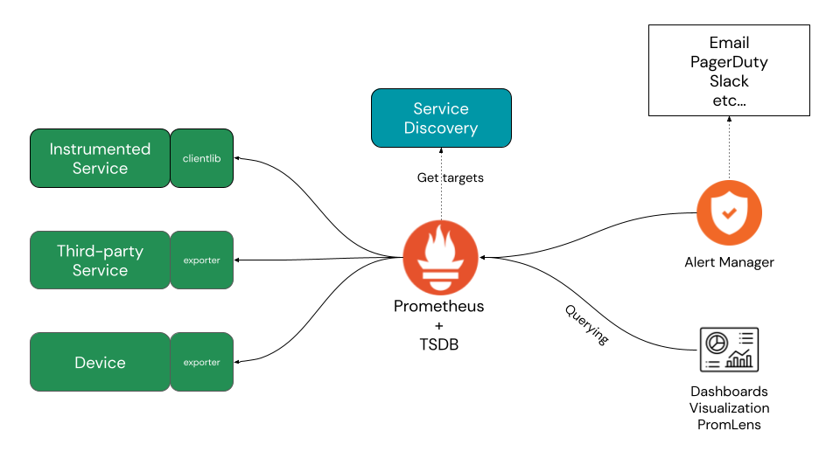
Learning 3 | My takeaways
Key learning
Prometheus is an open-source monitoring and alerting toolkit designed for reliability and scalability. It collects and stores metrics as time series data, providing powerful querying capabilities.
Grafana is an open-source analytics and monitoring platform that integrates with Prometheus to visualize metrics through customizable dashboards, enabling insightful data analysis.

Slide 7

Relevance of learnings for my organization

Slide 8
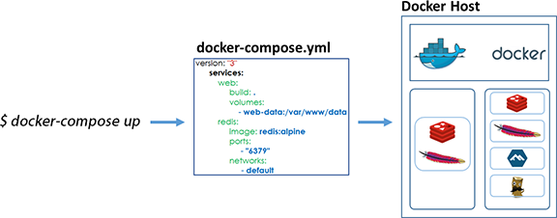
Learning 1 | Relevance for Shell
How I feel Shell implements this learning and How I feel Shell benefits from this learning
Implementing Docker and Docker Compose at Shell can streamline deployment processes, ensuring consistency across environments. This leads to improved productivity, as developers spend less time on configuration and more on development. Additionally, the scalability and reliability of applications are enhanced, resulting in more stable systems and efficient resource usage. Overall, Docker's integration can significantly benefit Shell's operations.

Slide 9
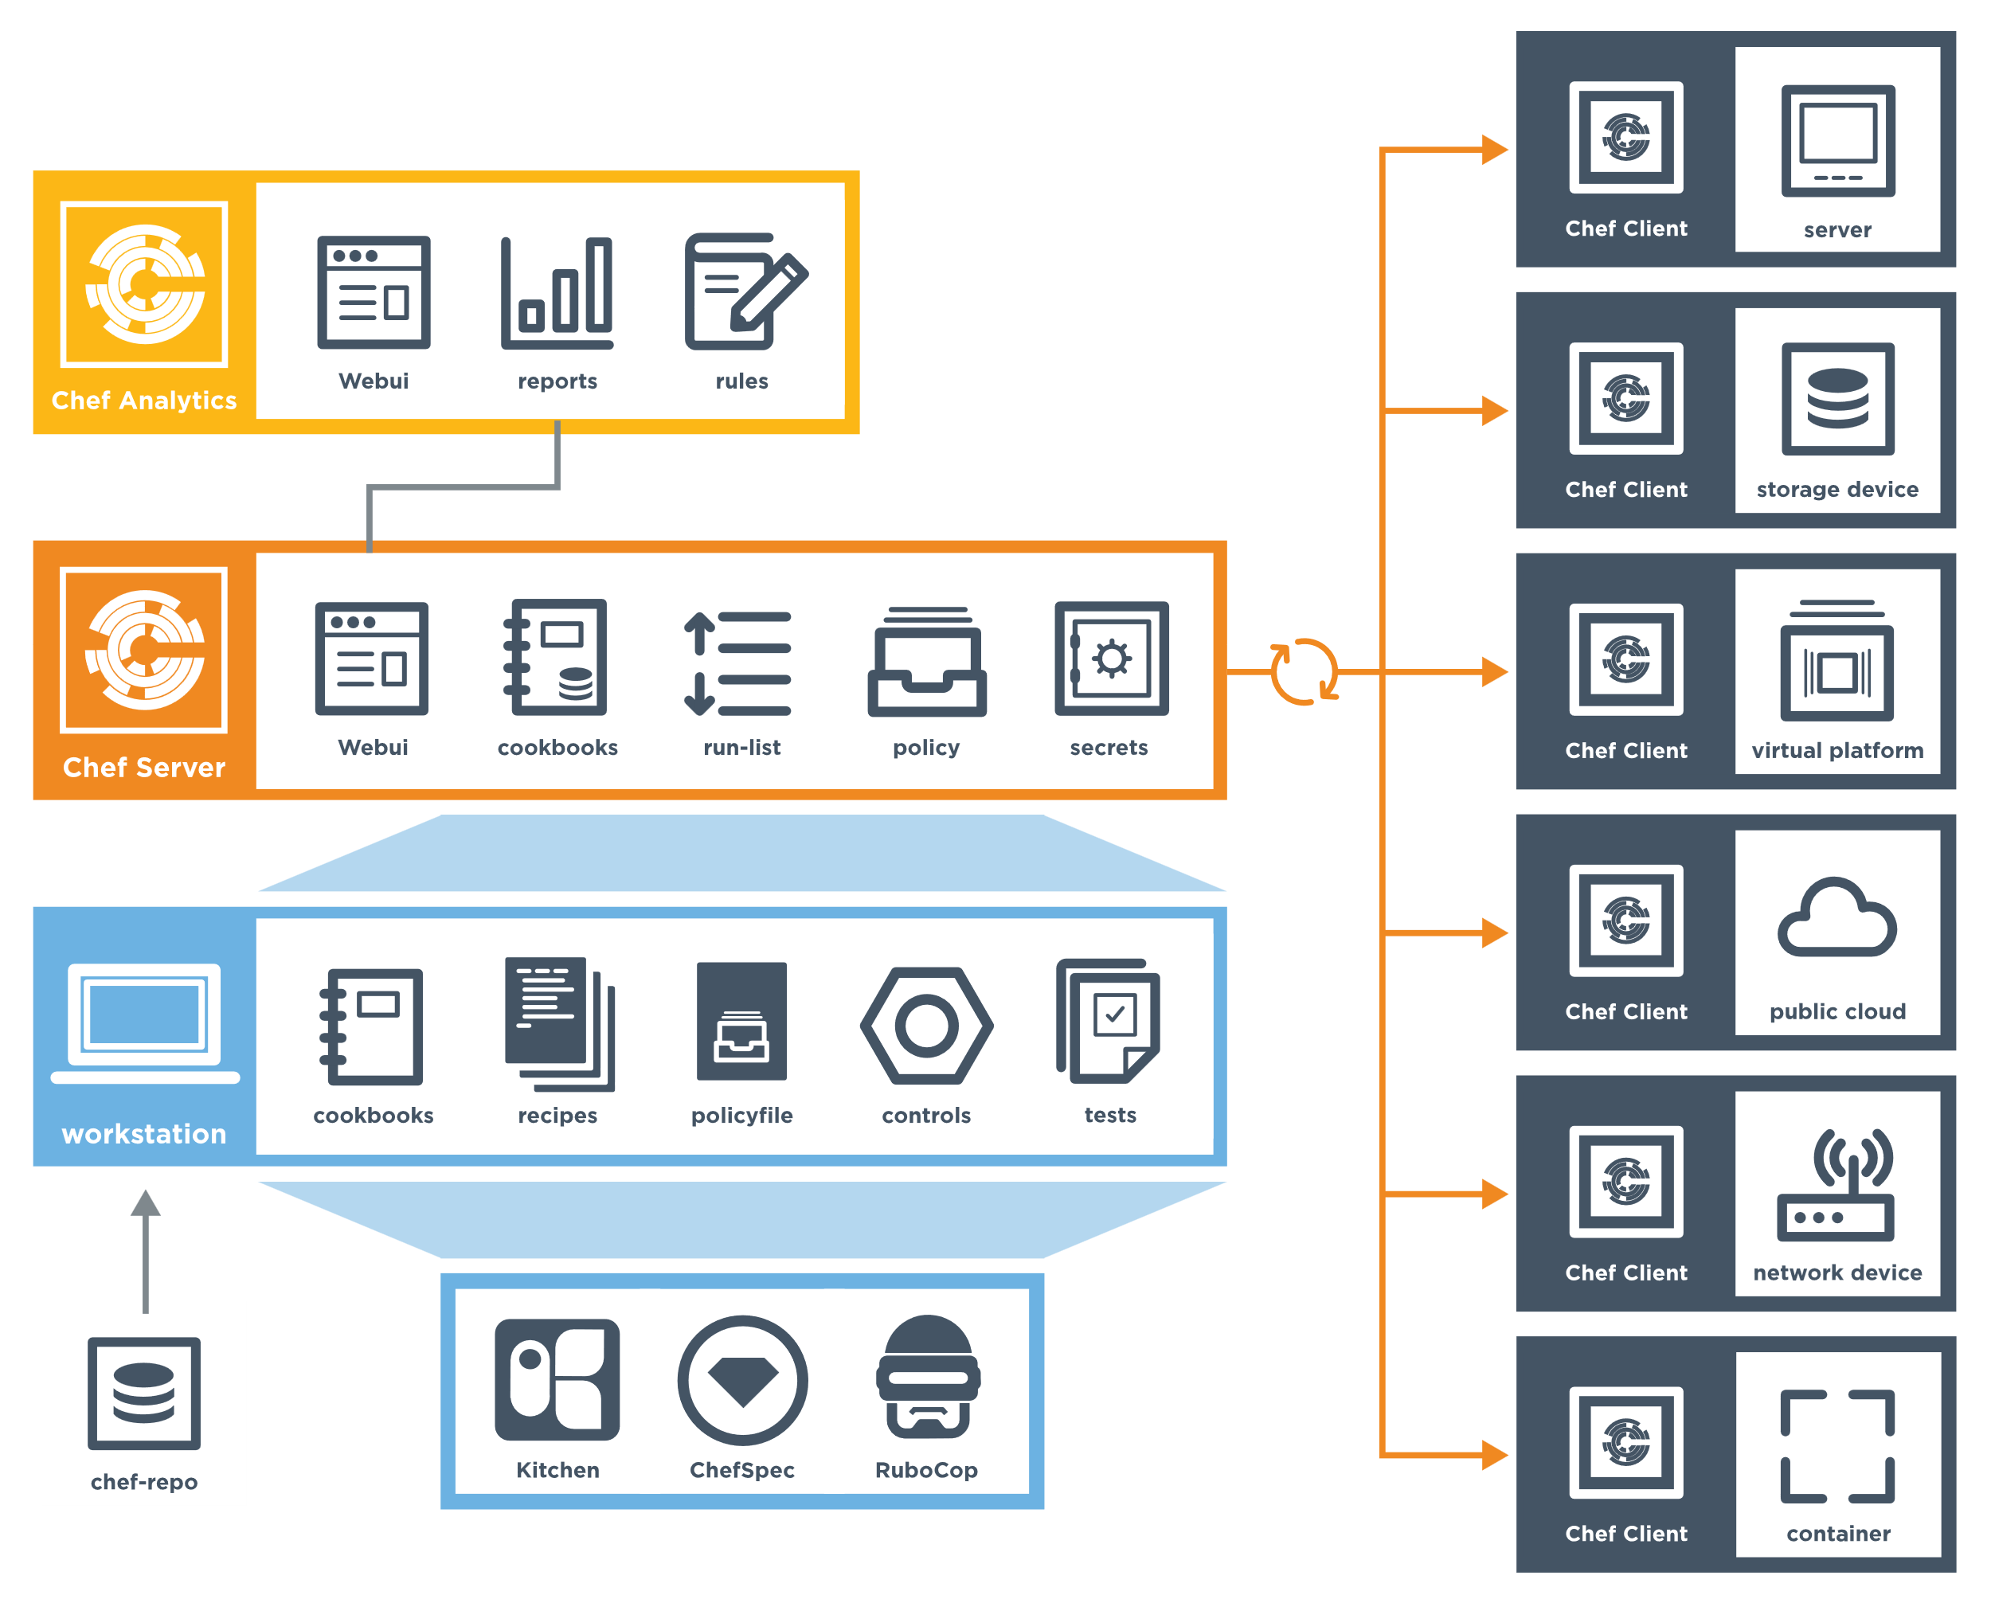
Learning 2 | Relevance for Shell
How I feel Shell implements this learning and How I feel Shell benefits from this learning
Implementing Chef at Shell can revolutionize infrastructure management. You might feel empowered by automating server configurations and deployments, ensuring consistency and scalability. This leads to increased efficiency and reliability, as infrastructure becomes code. Overall, Chef's integration can streamline operations, reduce manual errors, and enhance productivity, significantly benefiting Shell's IT processes.
This Photo by Unknown Author is licensed under CC BY-SA

Slide 10
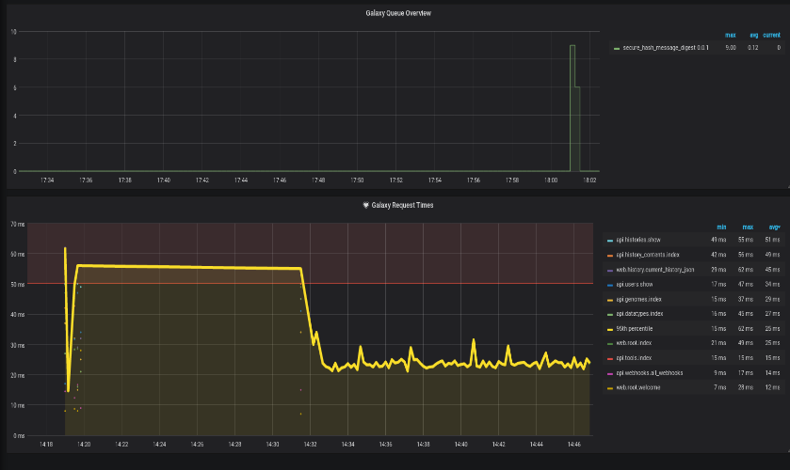
Learning 3 | Relevance for Shell
How I feel Shell implements this learning and How I feel Shell benefits from this learning
Implementing Prometheus and Grafana at Shell can enhance monitoring and visualization capabilities. You might feel more in control with real-time insights into system performance. This leads to proactive issue resolution and data-driven decision-making. Overall, integrating these tools can improve operational efficiency, system reliability, and provide valuable metrics for optimizing Shell's IT infrastructure.
This Photo by Unknown Author is licensed under CC BY

Slide 11

Challenges in implementing learning

Slide 12
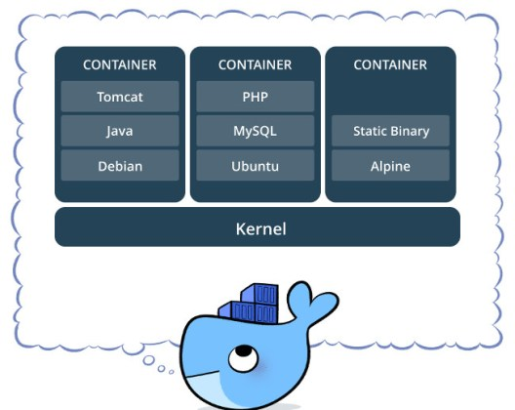
Challenge faced while implementing Learning 1
What were the challenges I faced while implementing Learning 1 and my plan to overcome them
Implementing Docker and Docker Compose at Shell, I faced challenges like managing container orchestration, ensuring security, and handling persistent storage. To overcome these, you can adopt best practices for container security, use orchestration tools like Kubernetes, and implement robust storage solutions. Continuous learning and collaboration with experienced colleagues can also help mitigate these challenges.

Slide 13
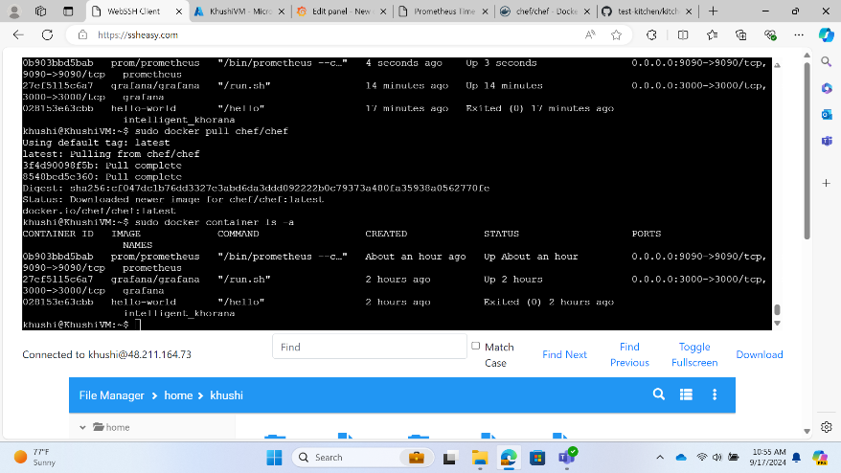
Challenge faced while implementing Learning 2
What were the challenges I faced while implementing Learning 2 and my plan to overcome them
Implementing Chef at Shell, I faced challenges like managing complex configurations, ensuring compatibility across environments, and handling version control. To overcome these, you can adopt a modular approach to configurations, use testing frameworks for compatibility, and implement robust version control practices. Continuous learning and collaboration with experienced colleagues can also help address these challenges.

Slide 14
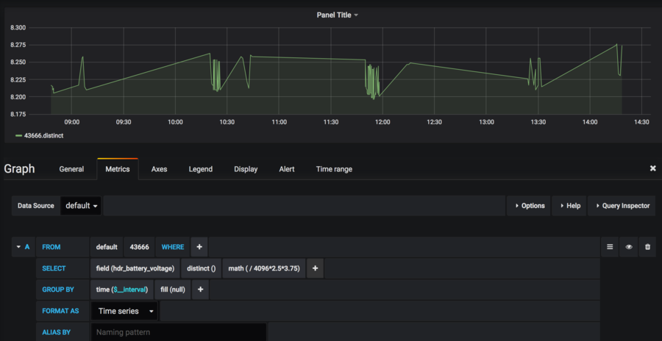
Challenge faced while implementing Learning 3
What were the challenges I faced while implementing Learning 3 and my plan to overcome them
Implementing Prometheus and Grafana at Shell, I faced challenges like handling large volumes of data, ensuring data accuracy, and managing complex dashboards. To overcome these, you can optimize data collection methods, implement robust validation processes, and simplify dashboard designs. Continuous learning and collaboration with experienced colleagues can also help address these challenges effectively.

Slide 15

Action Plan

Slide 16
My Action Plan for this Week
Actions
Timeline
Status
Deploying the Virtual Machine in Azure.
Learning how to work with Kubernetes and work on the case study.
Networking with colleagues.
1 Week
Ongoing

Slide 17

Learning is also Fun!

Slide 18

Learning is also Fun!
My learning was fun this week because of the following reasons:
Group activity
In-class presentations
Assessments and Quiz
Playing Games
Networking with colleagues

Slide 19

Summary
Integrating Chef, Prometheus, Grafana, Docker, and Docker Compose enhances infrastructure efficiency and observability.
Chef automates application deployment and management, ensuring consistency.
Prometheus collects and stores metrics, while Grafana visualizes them, providing real-time insights.
Docker and Docker Compose simplify the deployment of these tools as containers, streamlining setup and management.
This combination creates a robust solution for infrastructure management and monitoring, improving operational efficiency and system reliability.

Slide 20
Thank You

